Slide 2

TIME SERIES ANALYSIS ON
STOCK MARKET
Project Guide
Mr. Bikram Pratim Bhuyan

Slide 3
Team Members & Role
ROLL NO. | BRANCH | NAME | ROLE
R103216079 | CSE-BAO | RAJESHWARPREET S BOPARAI | Designing, Coding , Testing and Implementation Designing, Coding, Testing and Implementation Designing, Coding, Testing and Implementation
R103216098 | CSE-BAO | SMARTH GALHOTRA
R103216126 | CSE-BAO | ANISHA GERA

Slide 4


PROBLEM STATEMENT
What trends have been followed by this stock index in the past?
Is this the right time to invest?
Would it be beneficial to "Play the long game"?

Slide 5

THE HISTORY OF FORECASTING
Well....the future seems disastrous
Should I buy Reliance ltd. Shares??

Slide 6

ABSTRACT
“It’s Easier to Look Back Than to Look Into the Future”

Slide 7

INTRODUCTION
Ability to predict stock accurately is crucial for market dealers or investors to maximize the profits.
As time plays vital role in stock prediction, so time series analysis is the most efficient approach.
The most recommendable model is ARIMA that first transforms the series rather than forecasting directly.

Slide 8


LITERATURE REVIEW
Majority of researchers have believed that ARIMA is the most efficient model to forecast stock returns as it is a tedious task to guess the pattern of the stock exchange.
The authors Adebiyi et al Adewunmi have used the ARIMA model to predict Nokia and Zenith Bank stock prices on short-term basis.
The authors Jung-Hua wang et al Jia-Yann leu forecast mid-term price trend in Taiwan stock market. The system is based on neural network trained by using features extracted from ARIMA analysis.

Slide 9

OBJECTIVE
Build an efficient predictive model that can help investors to take decision.

Slide 10
METHODOLOGY
INPUT DATA
DATA REDUCTION
CREATE TIME SERIES
DECOMPOSE DATA
PREDICT FUTURE STOCK USING ARIMA MODEL
Architecture of Stock Prediction Model

Slide 11



METHODOLOGY
PHASE-1
DATA PREPARATION
MODEL SELECTION
PHASE-2
ESTIMATION
DIAGNOSTIC
PHASE-3
FORECASTING THE STOCK

Slide 12

METHODOLOGY
Exploratory data analysis- Stationarity check
Modelling- Moving Average
Exponential Smoothing
ARIMA
Exponential Smoothing:

Slide 13
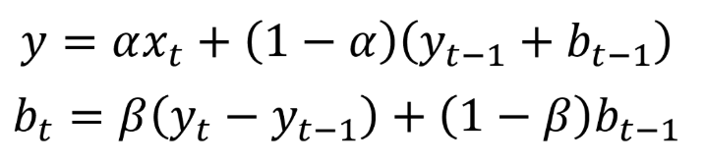
METHODOLOGY
Double Exponential Smoothing:
Mathematical expression-
Stationarity Check: Dickey-Fuller test- define null hypothesis as series is non-stationary.

Slide 14
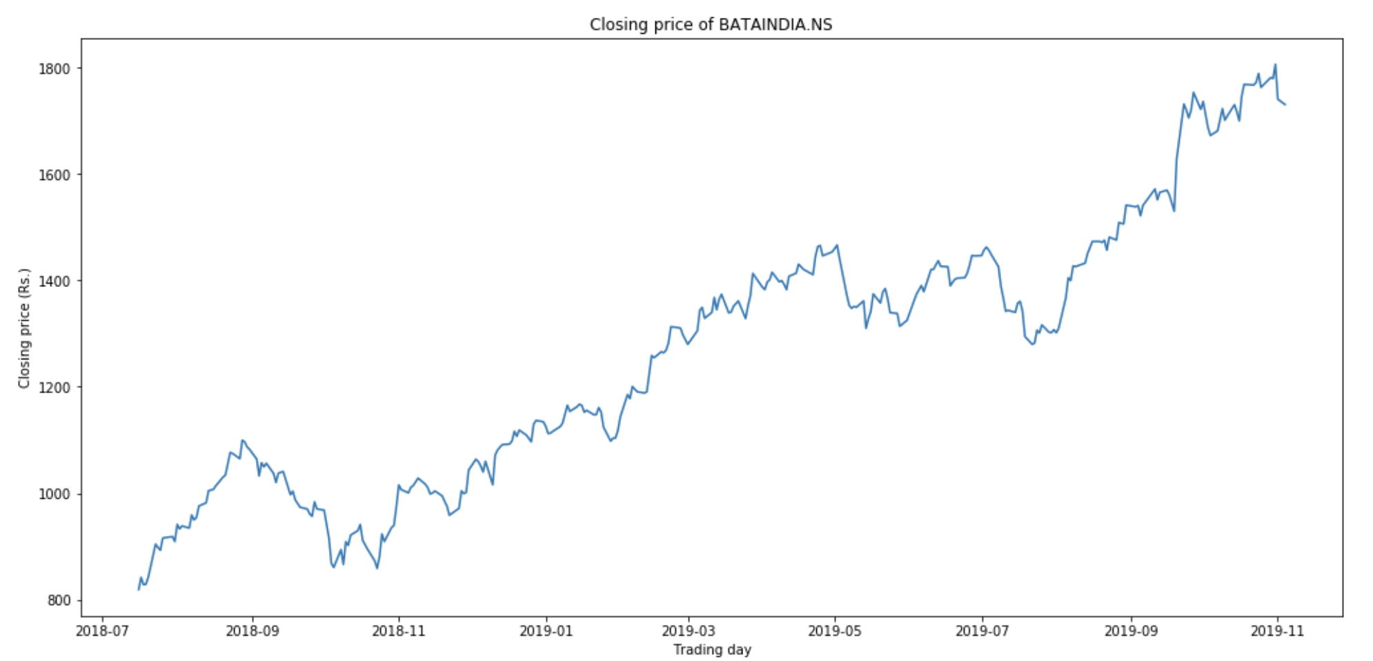
Modelling of Time Series

Slide 15
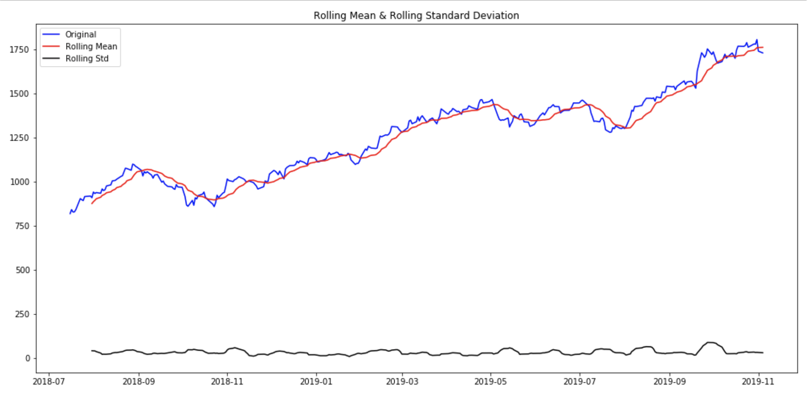
Modelling of Time Series contd...

Slide 16
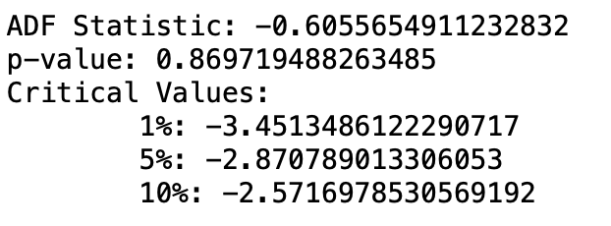
Augmented Dickey-Fuller Test
On Index Closing Price

Slide 17
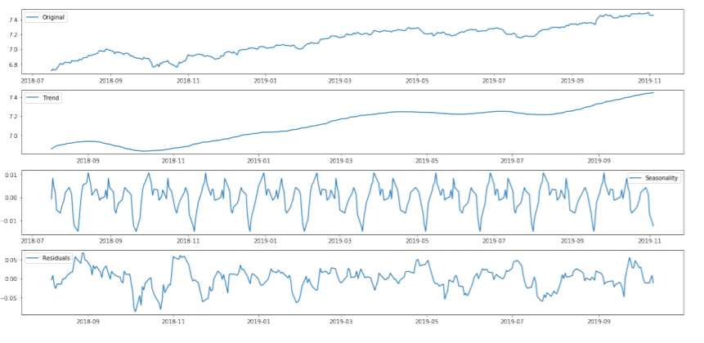
Seasonal Decomposition

Slide 18
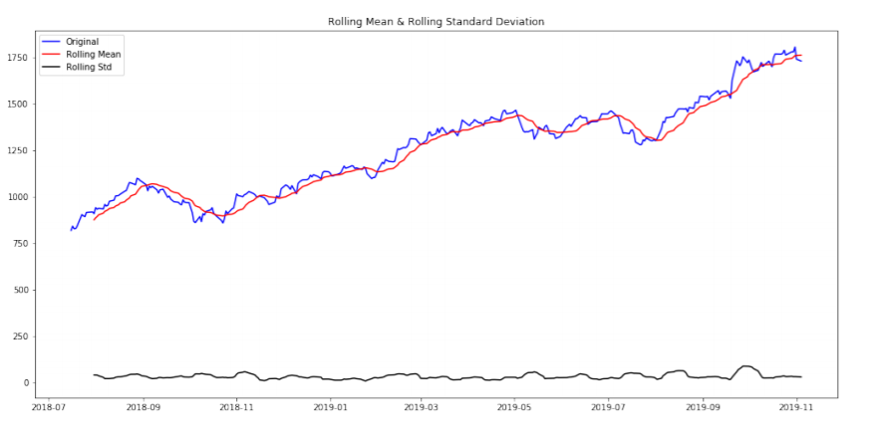
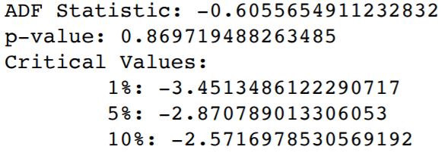

Slide 19
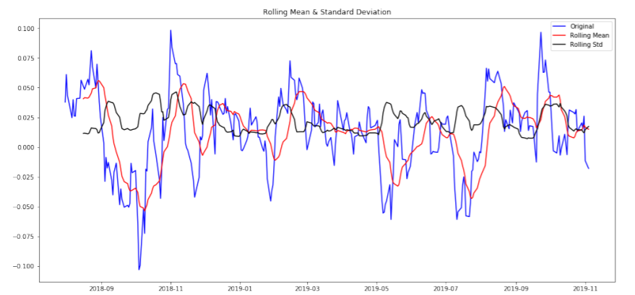
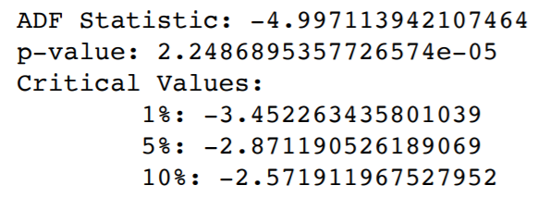

Slide 20
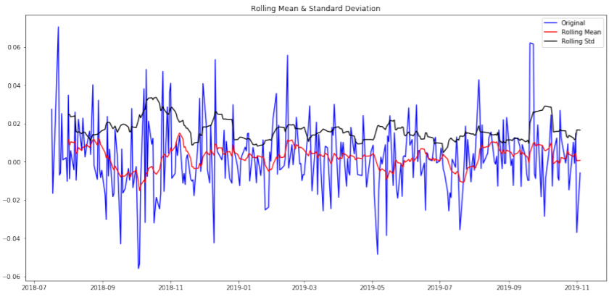
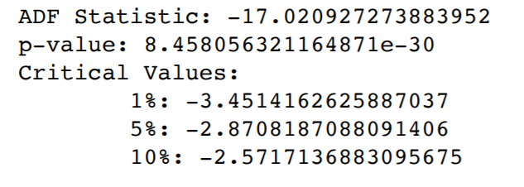

Slide 21
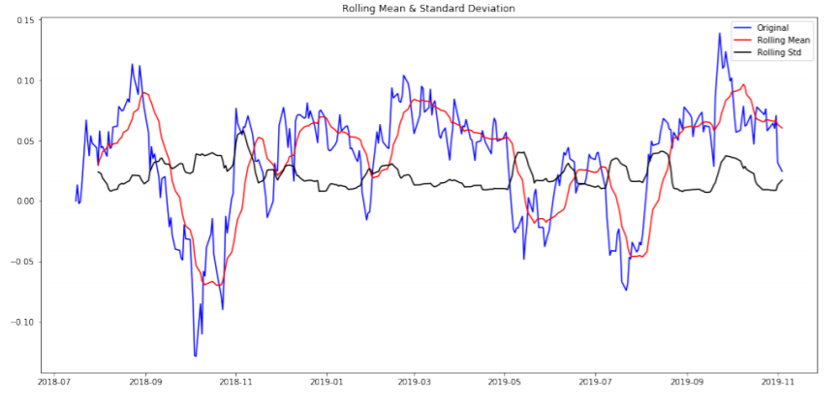
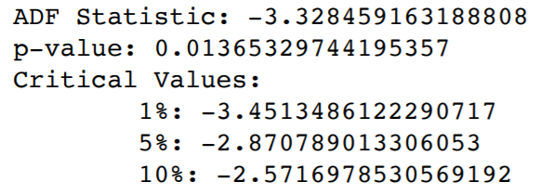

Slide 22
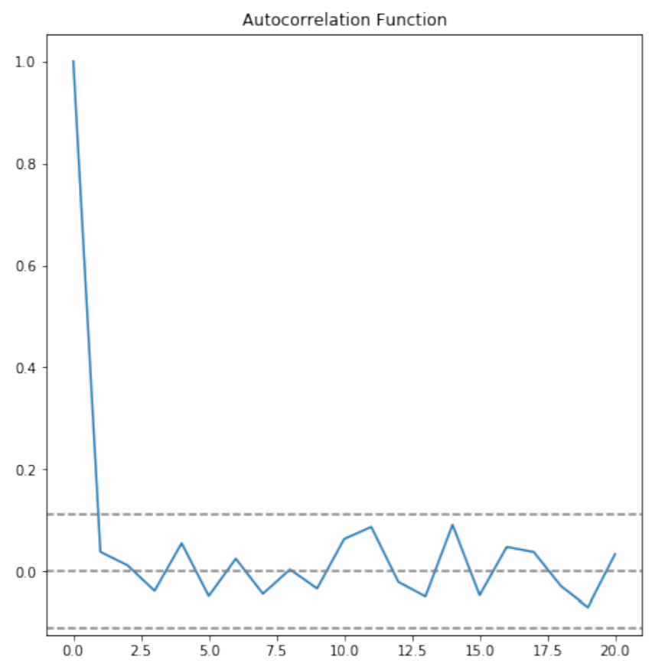
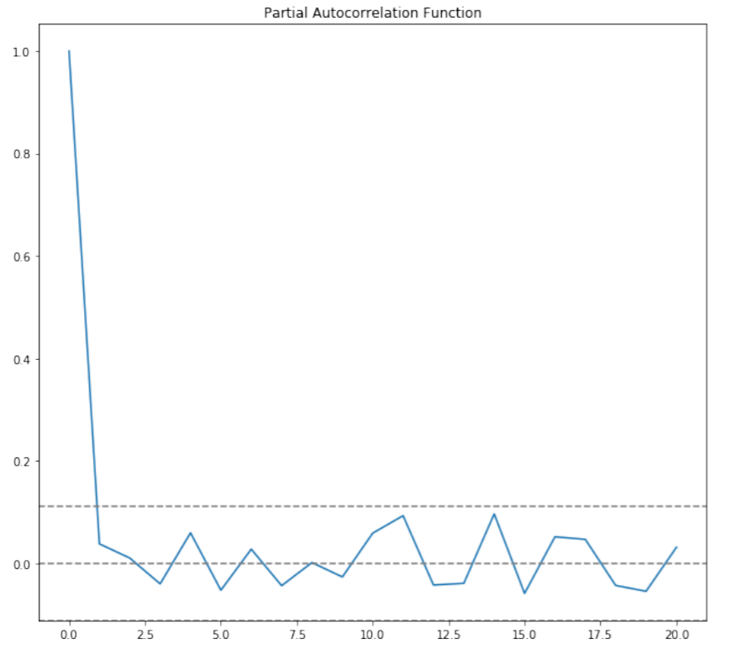

Slide 23
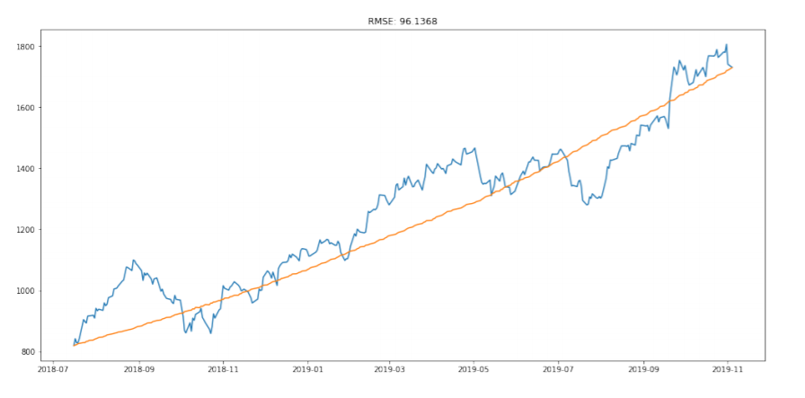

Slide 24
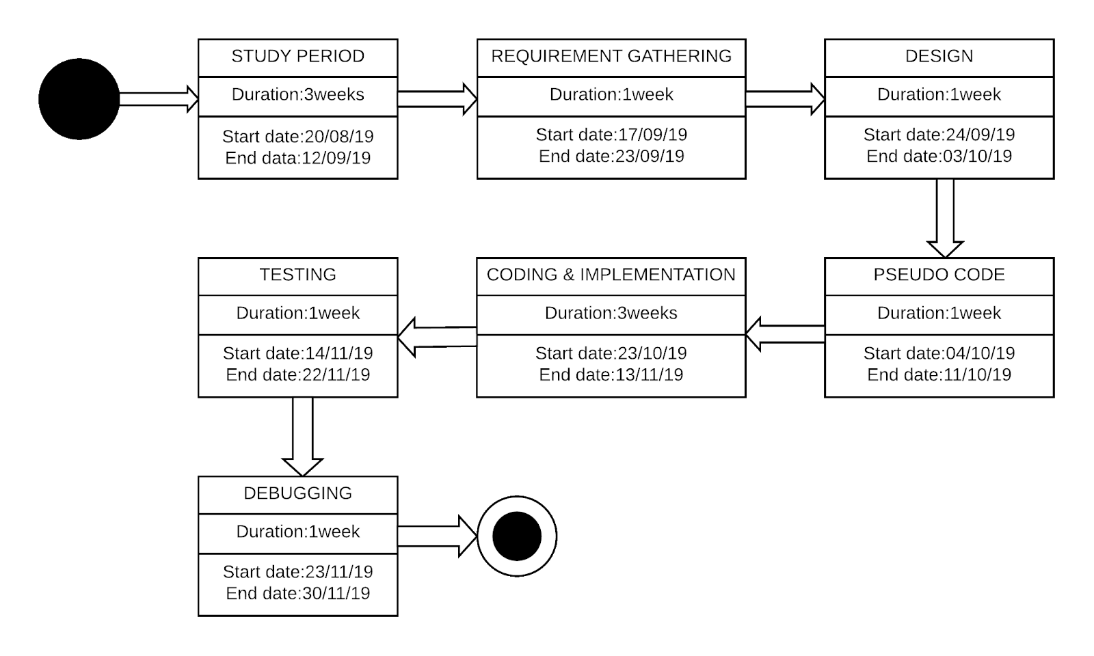
SCHEDULE

Slide 25

References
[1] “Ayodele A. Adebiyi et al Aderemi O. Adewumi, Charles K. Ayo, "Stock price prediction using the ARIMA model", 16th
IEEEInternational Conference on Computer Modelling and Simulation(UKSim), (March 2014), pp.106-112.
[2]Amogh P. Kulkarni “Time Series Data Analysis for Stock Market Prediction using Data Mining Techniques with R”,International Journal of Advanced Research in Computer Science,ISSN NO-0976-5697.
[3]“11 Classical Time Series Forecasting Methods in Python”(August 6, 2018). Retreived from www.machinelearningmastery.com/time-series-forecasting-methods-in-python-cheat-sheet.
[4]Farhan Islam Hira (2018). Stock Market Prediction Using Time Series Analysis. BRAC University, Dhaka
[5]“Create an ARIMA model for time series forecasting in python” (January 9,2017). Retrieved from www.machinelearningmastery.com/arima-for-time-series-forecasting-with-python

